Slide 1
LICENCE WEB API 2.0
Created By : Akash Patni

Slide 2
WEB APPLICATION

Slide 3
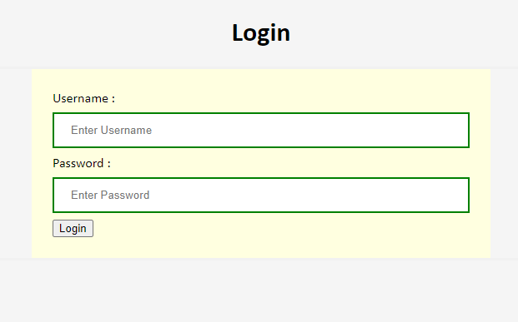
Login Screen
Username : SuperAdmin
Password : SuperAdmin
Notes:
Username : SuperAdmin
Password : SuperAdmin

Slide 4
Feature List
Logout Button
Select Columns : Help to select column which user want to filter and sorting .
Search : User can search in table based on column selection from dropdown .
Asc Sort : Display table list in ASC order based on column selection from dropdown .
Desc Sort : Display table list in Desc order based on column selection from dropdown .
New Licence : Add new licence in list and stored in database .
Delete : Remove licence from list .
Download : Download licence data in json format from list .
Pagination : Display 10 rows per page and total no of pages for all data .

Slide 5
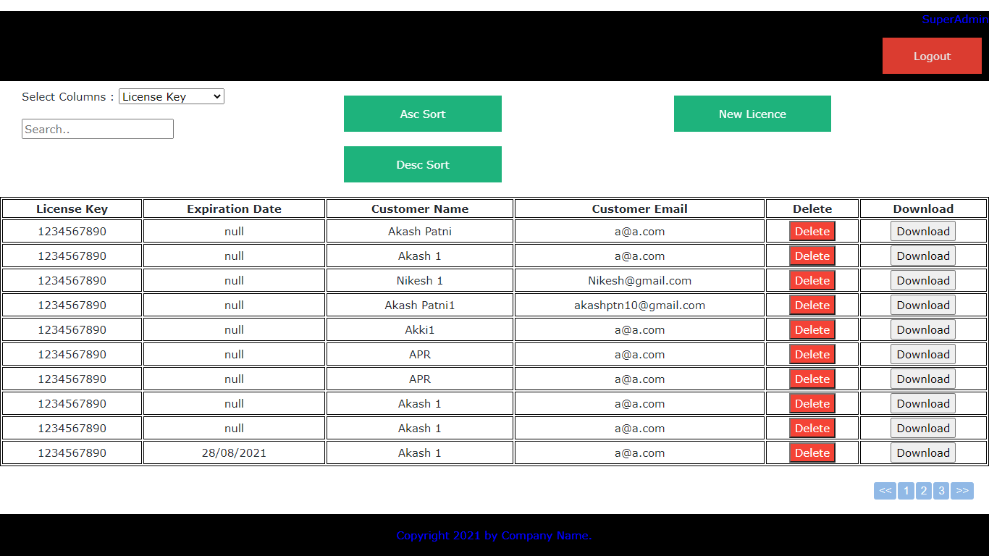
Licence List
1
2
5
4
6
8
3
7
9

Slide 6
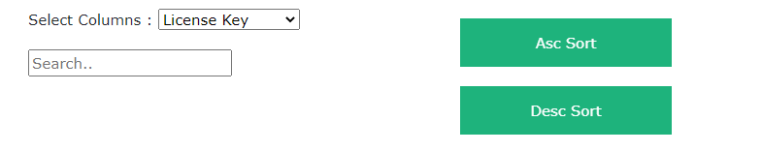
Filter and Sorting
For filter and sorting user need to select column name dropdown.
Base on dropdown column selection filter and sorting operation will be performed on table.

Slide 7
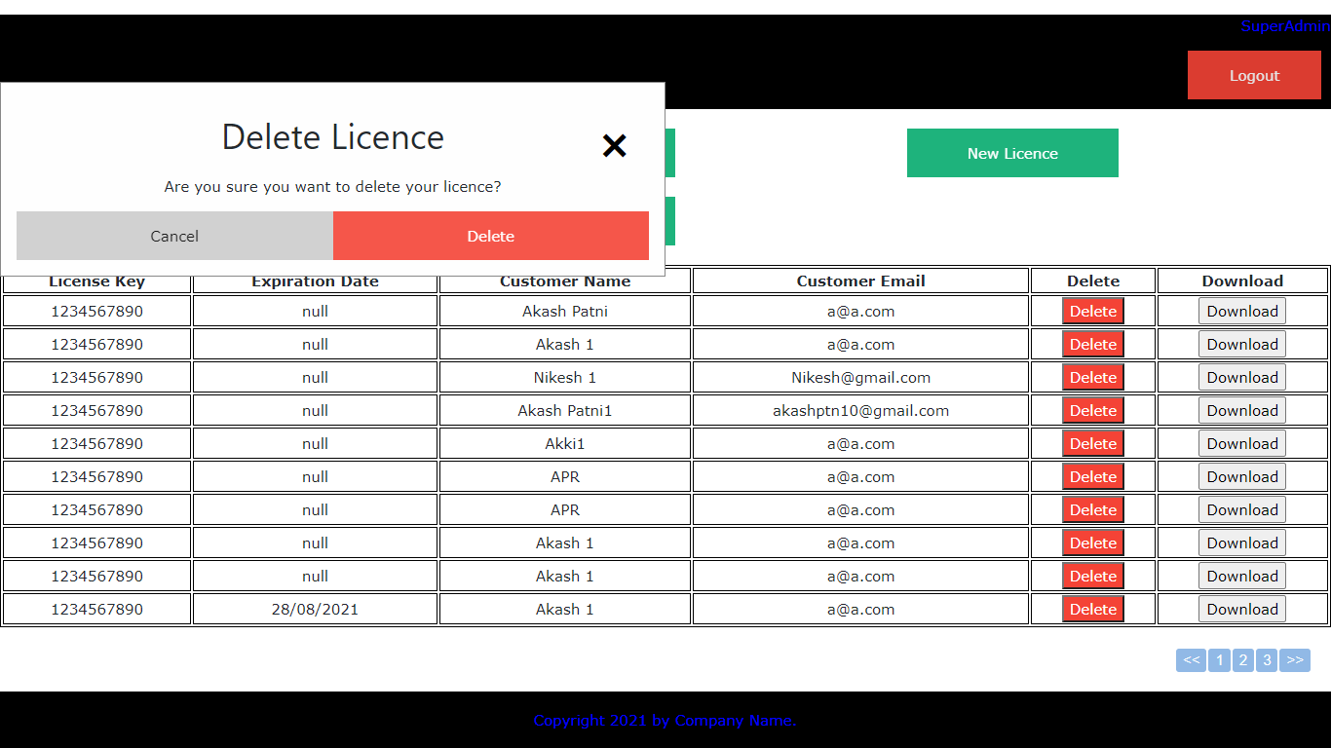
Delete Popup

Slide 8
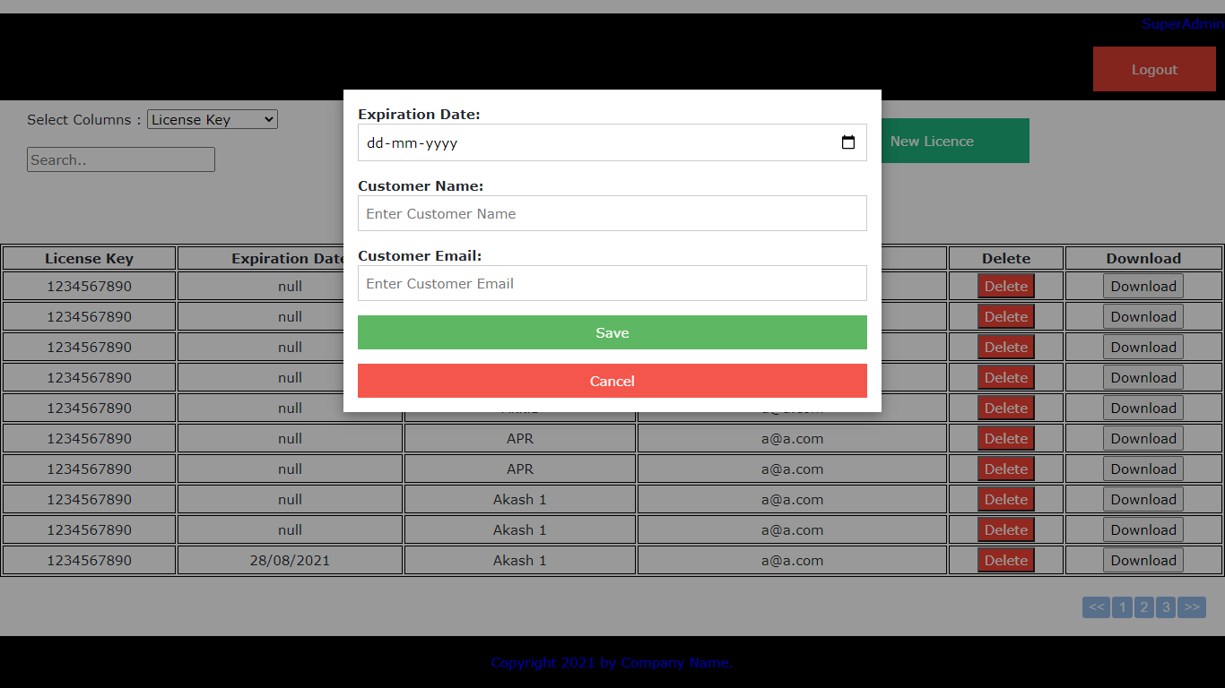
Add New Licence Popup

Slide 9
WEB API 2.0

Slide 10
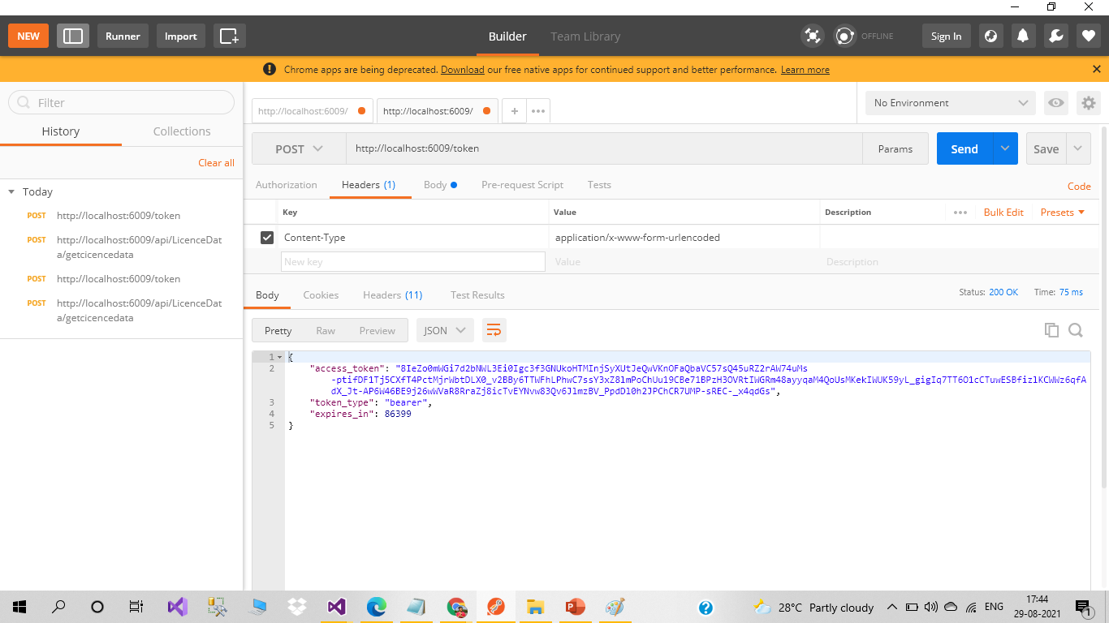
Token Generation Header

Slide 11
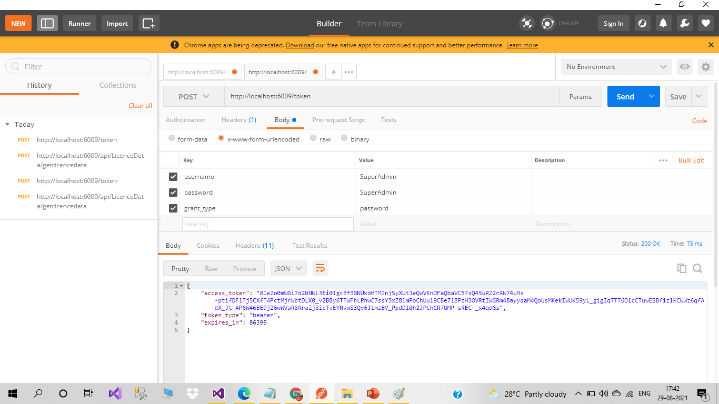
Token Generation Body

Slide 12
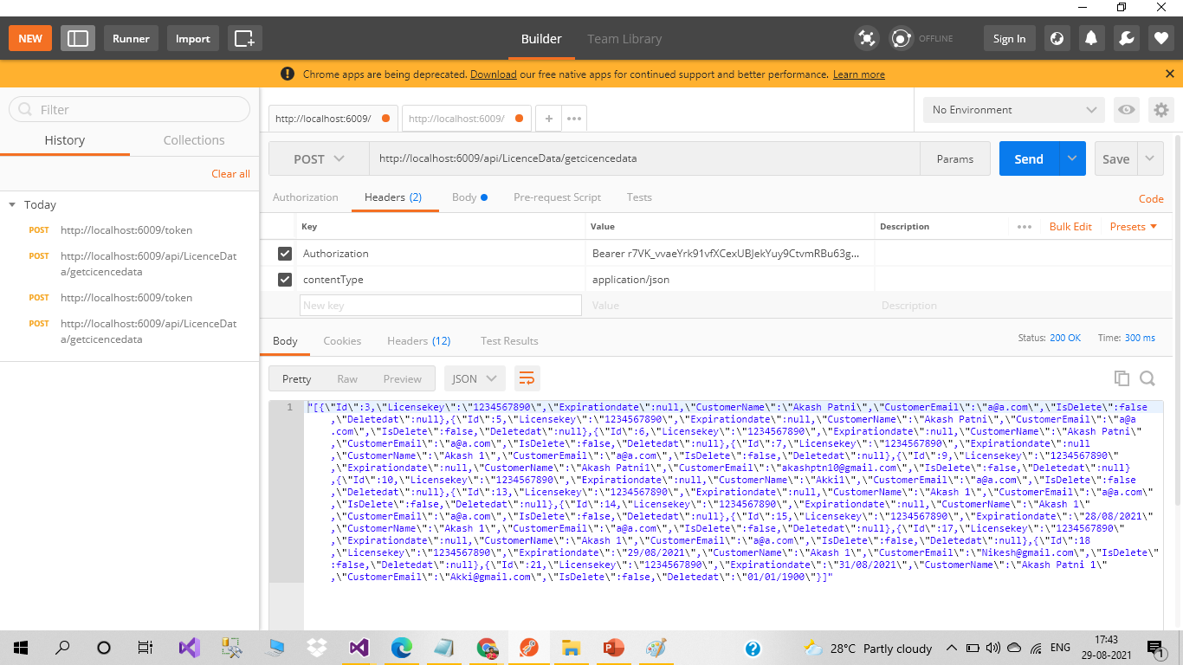
Get Licence Data Header

Slide 13
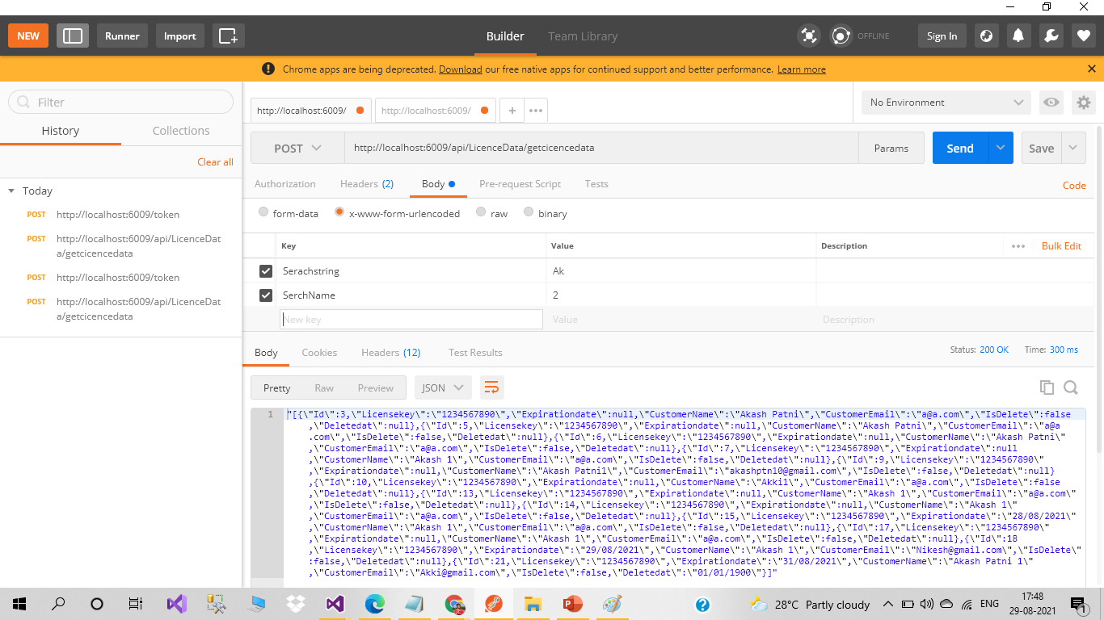
Get Licence Data Body

Slide 14
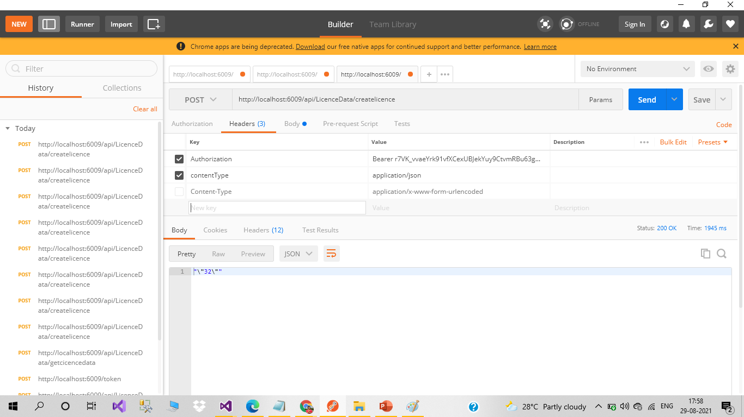
Add New Licence Header

Slide 15
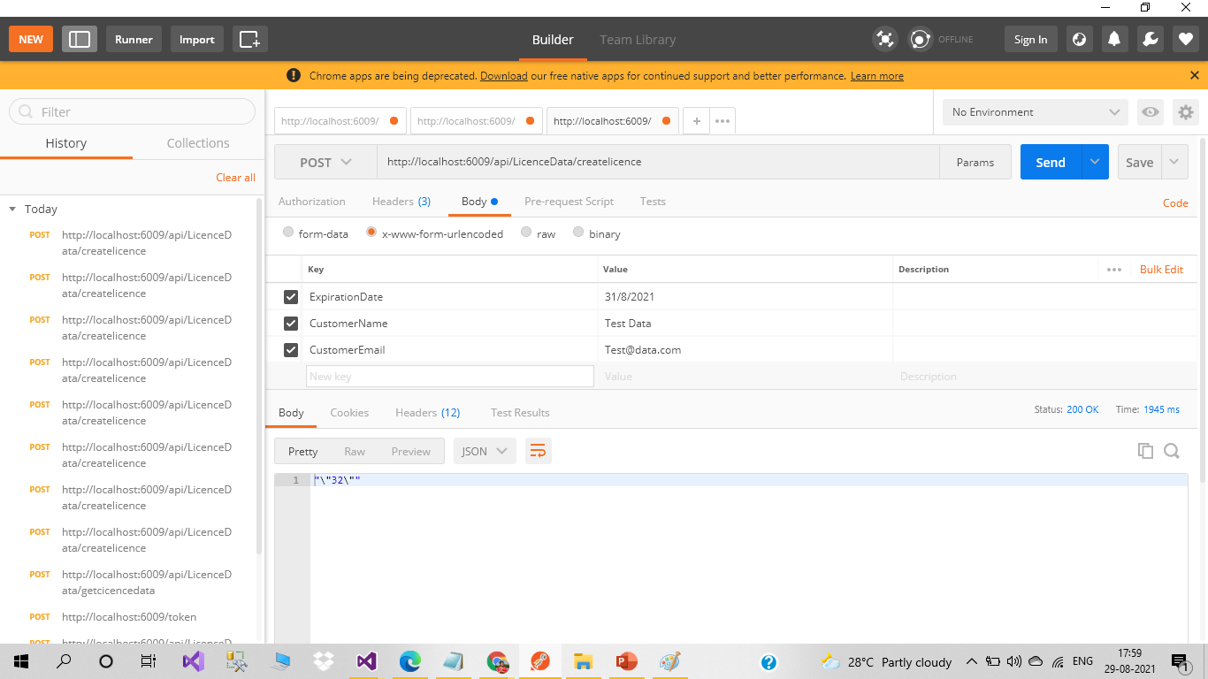
Add New Licence Body

Slide 16
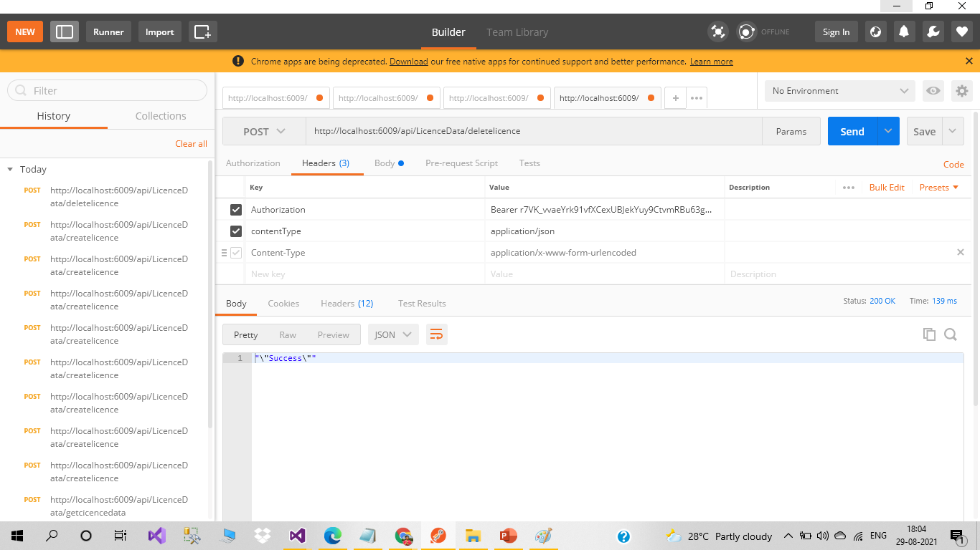
Delete Licence Header

Slide 17
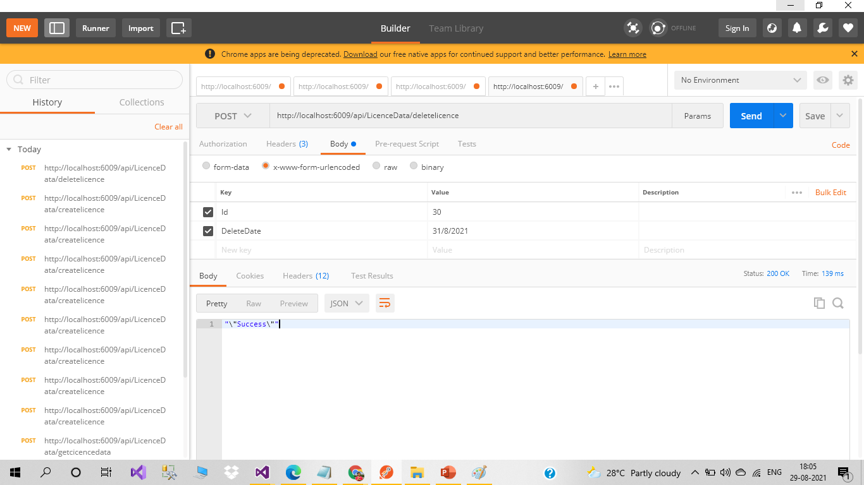
Delete Licence Body

Slide 18

Instruction for team to run WEB APP
Change Web Api path in common.js

Slide 19

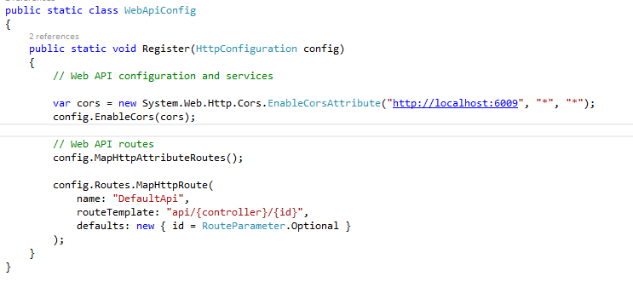
Instruction for team to run WEB API
Change database connection string in web.Config file in LicenceAPI .
Change in WebApiConfig cors path of deployed web api path .

Slide 20
THANK YOU…..

